Slide 1

BIG DATA PROJECT RISK FACTOR ANALYSIS
GROUP 2:
Ranjitha Shivaprasad Ballakuraya, I-Ching Wang, Muhammad Daniyal

Slide 2
Problem Statement
To calculate and predict risk factors for the identification of drivers based on various factors such as events, total distances they travel, their average speeds and mileage.
Identify the risky drivers by analyzing the dataset based on various factors like geographic location, vehicles, average mileage, gas consumption, events and risk factors.
To minimize the risks associated with each driver by analyzing their data so that we can help in the reductions of accidents being caused by large commercial trucks causing less injuries and deaths in California.

Slide 3
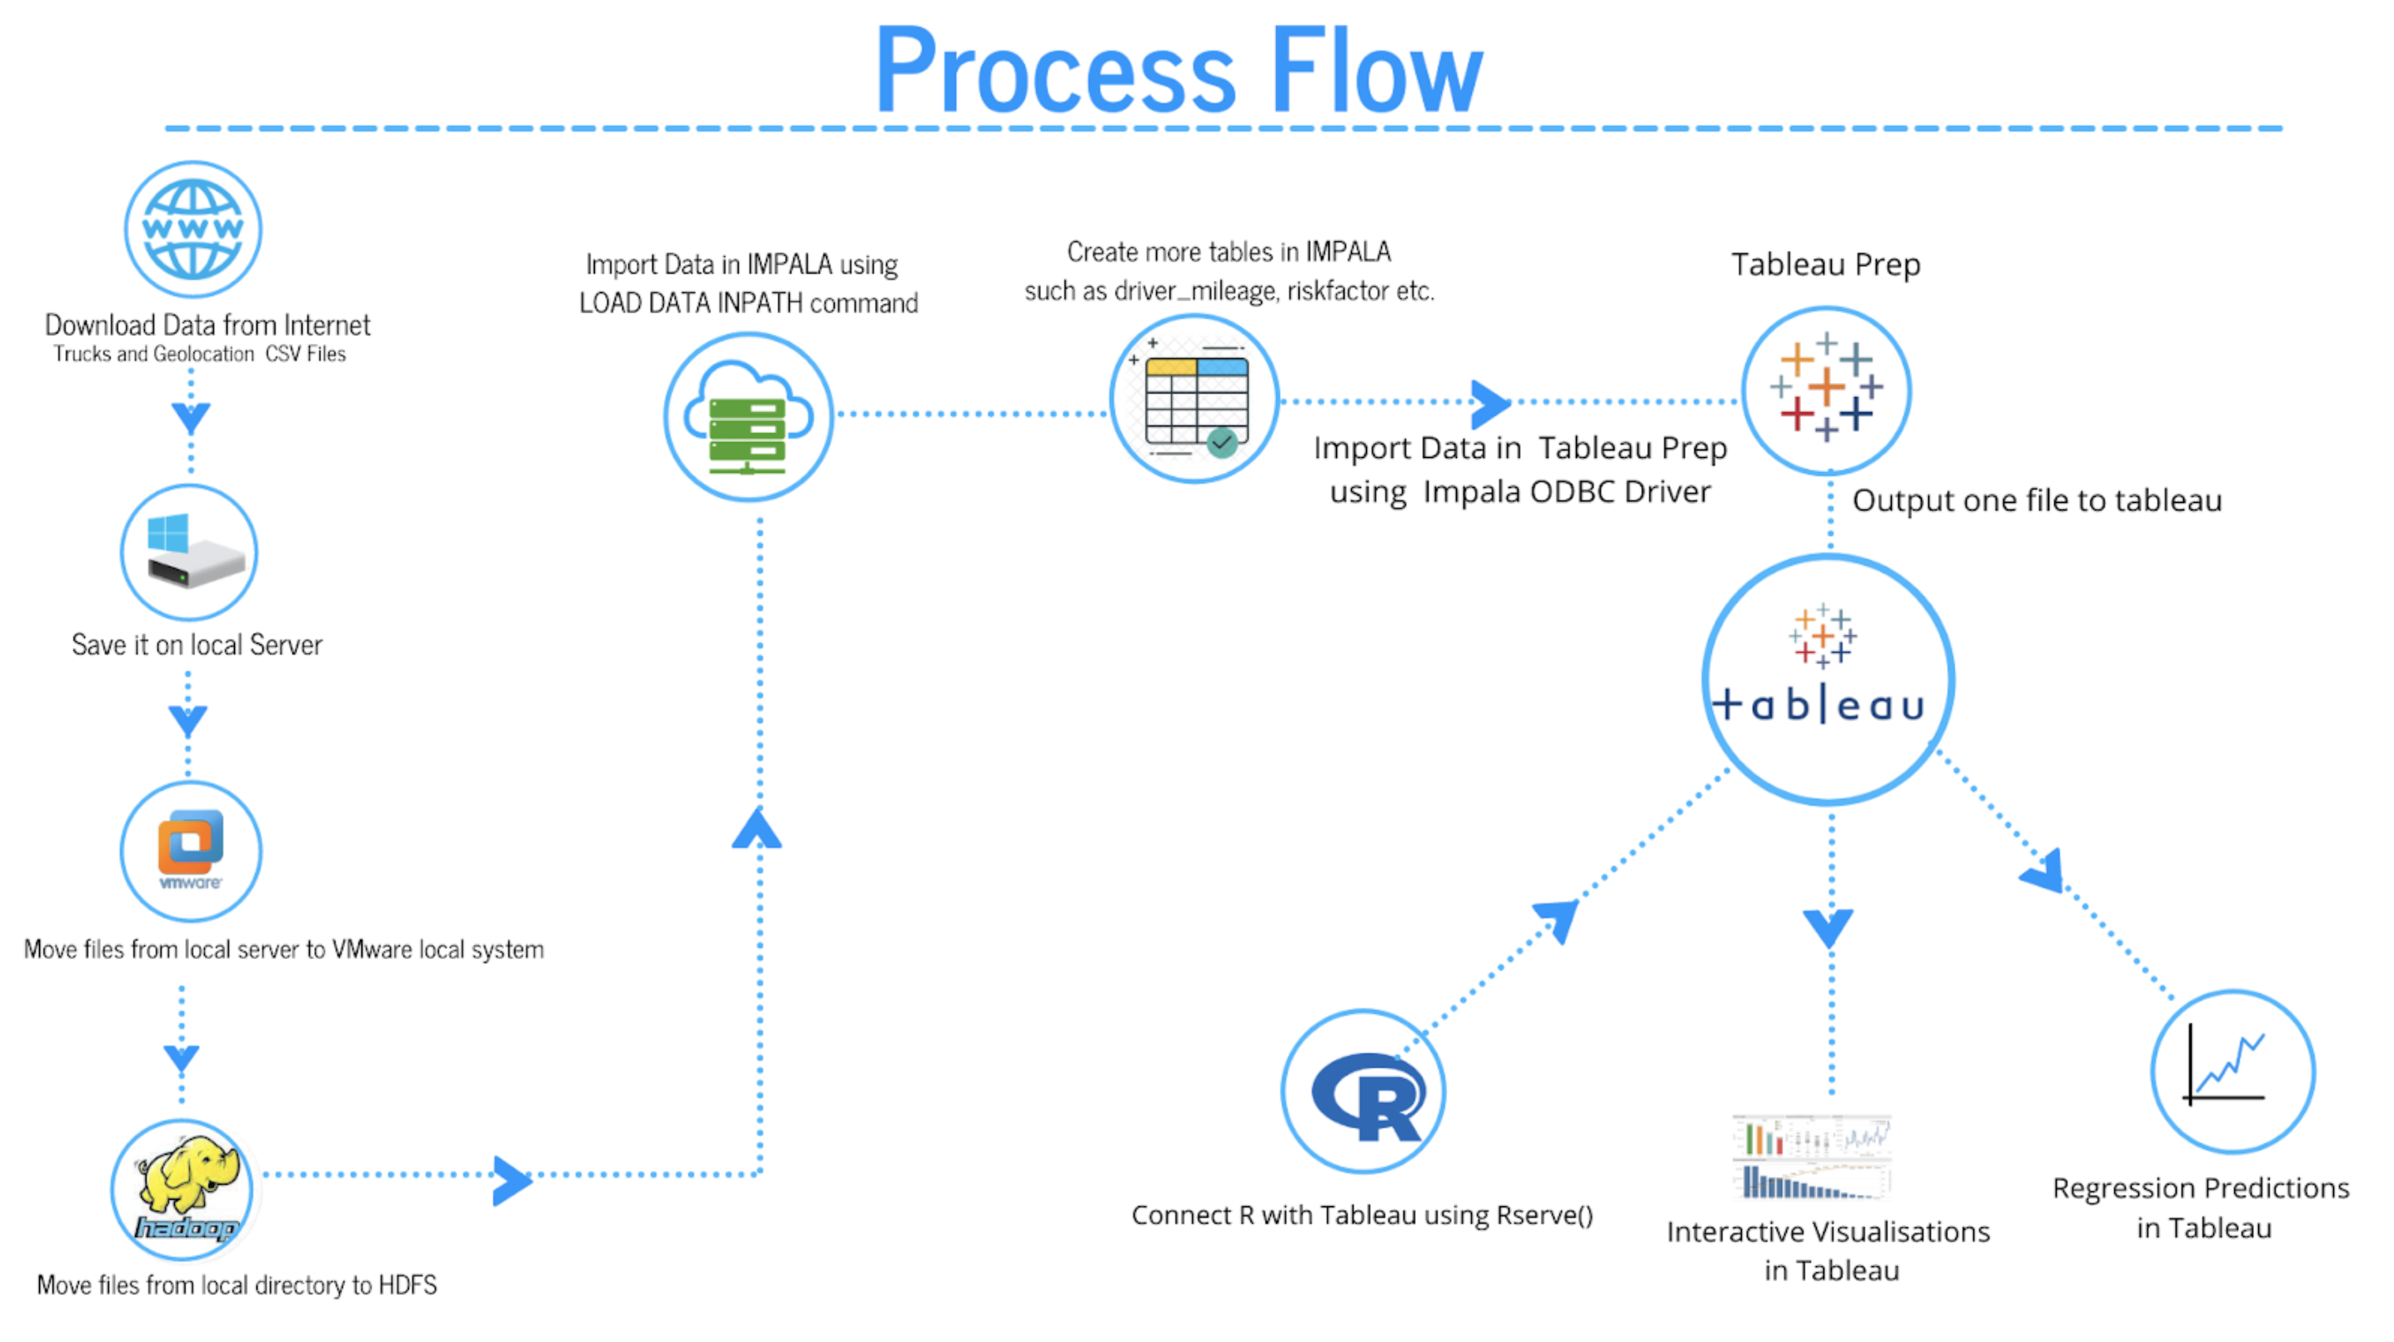
Notes:
Download data from the internet ( Trucks and Geolocation csv files)
Save files on our own local system.
Move files to the VMware local system.
Move files from local system to HDFS.
Import geolocation and trucks tables in IMPALA using LOCAL DATA INPATH command.
We created more tables in IMPALA such as driver_mileage and riskfactor etc.
We connect Impala with Tableau using ODBC driver to create interactive visualizations.
Integration of R with Tableau.
Running a Linear Regression on Tableau using Rserve()

Slide 4
About the Dataset
Trucks
Truck_Mileage
Avg_mileage
Initially two files
Geolocation
Driver_Mileage
Important Columns For Modelling:
Driver_Average_mileage
Total Miles
Number of Events
Speed
Risk Factor
Scaled Risk Factor using min max approach
Risk Factor

Slide 5
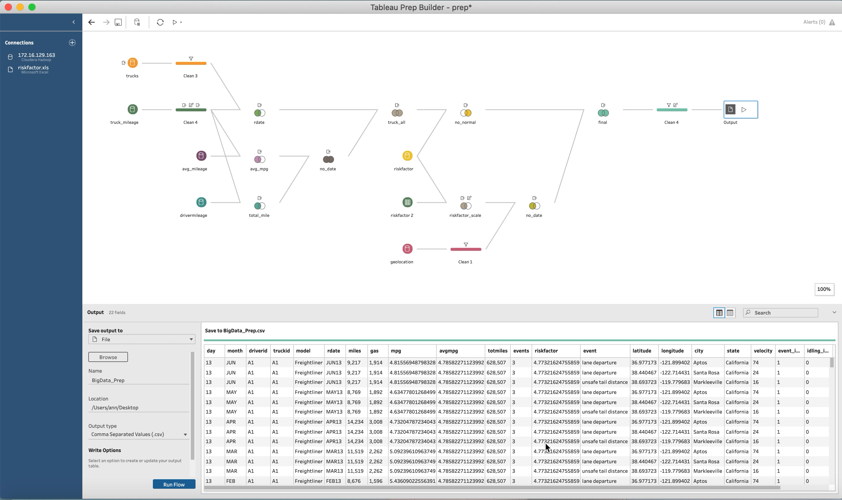
Data Cleansing in Tableau Prep
We clean the data in Tableau Prep since we find it is a quicker and easier way to understand the data structure and join all tables.

Slide 6
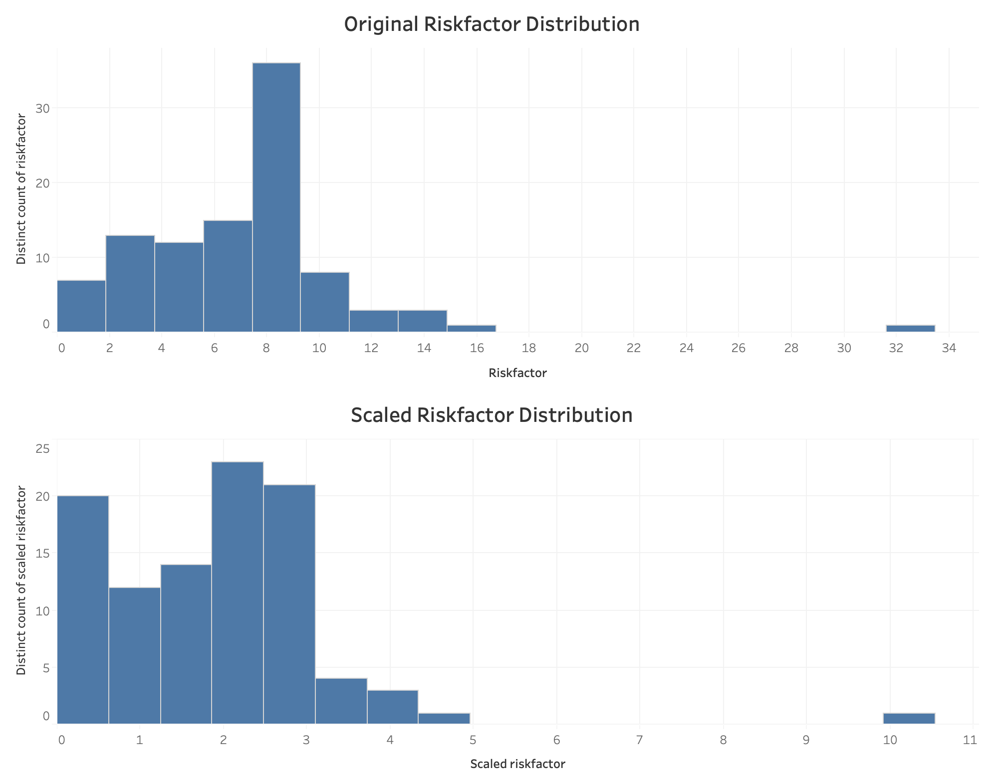
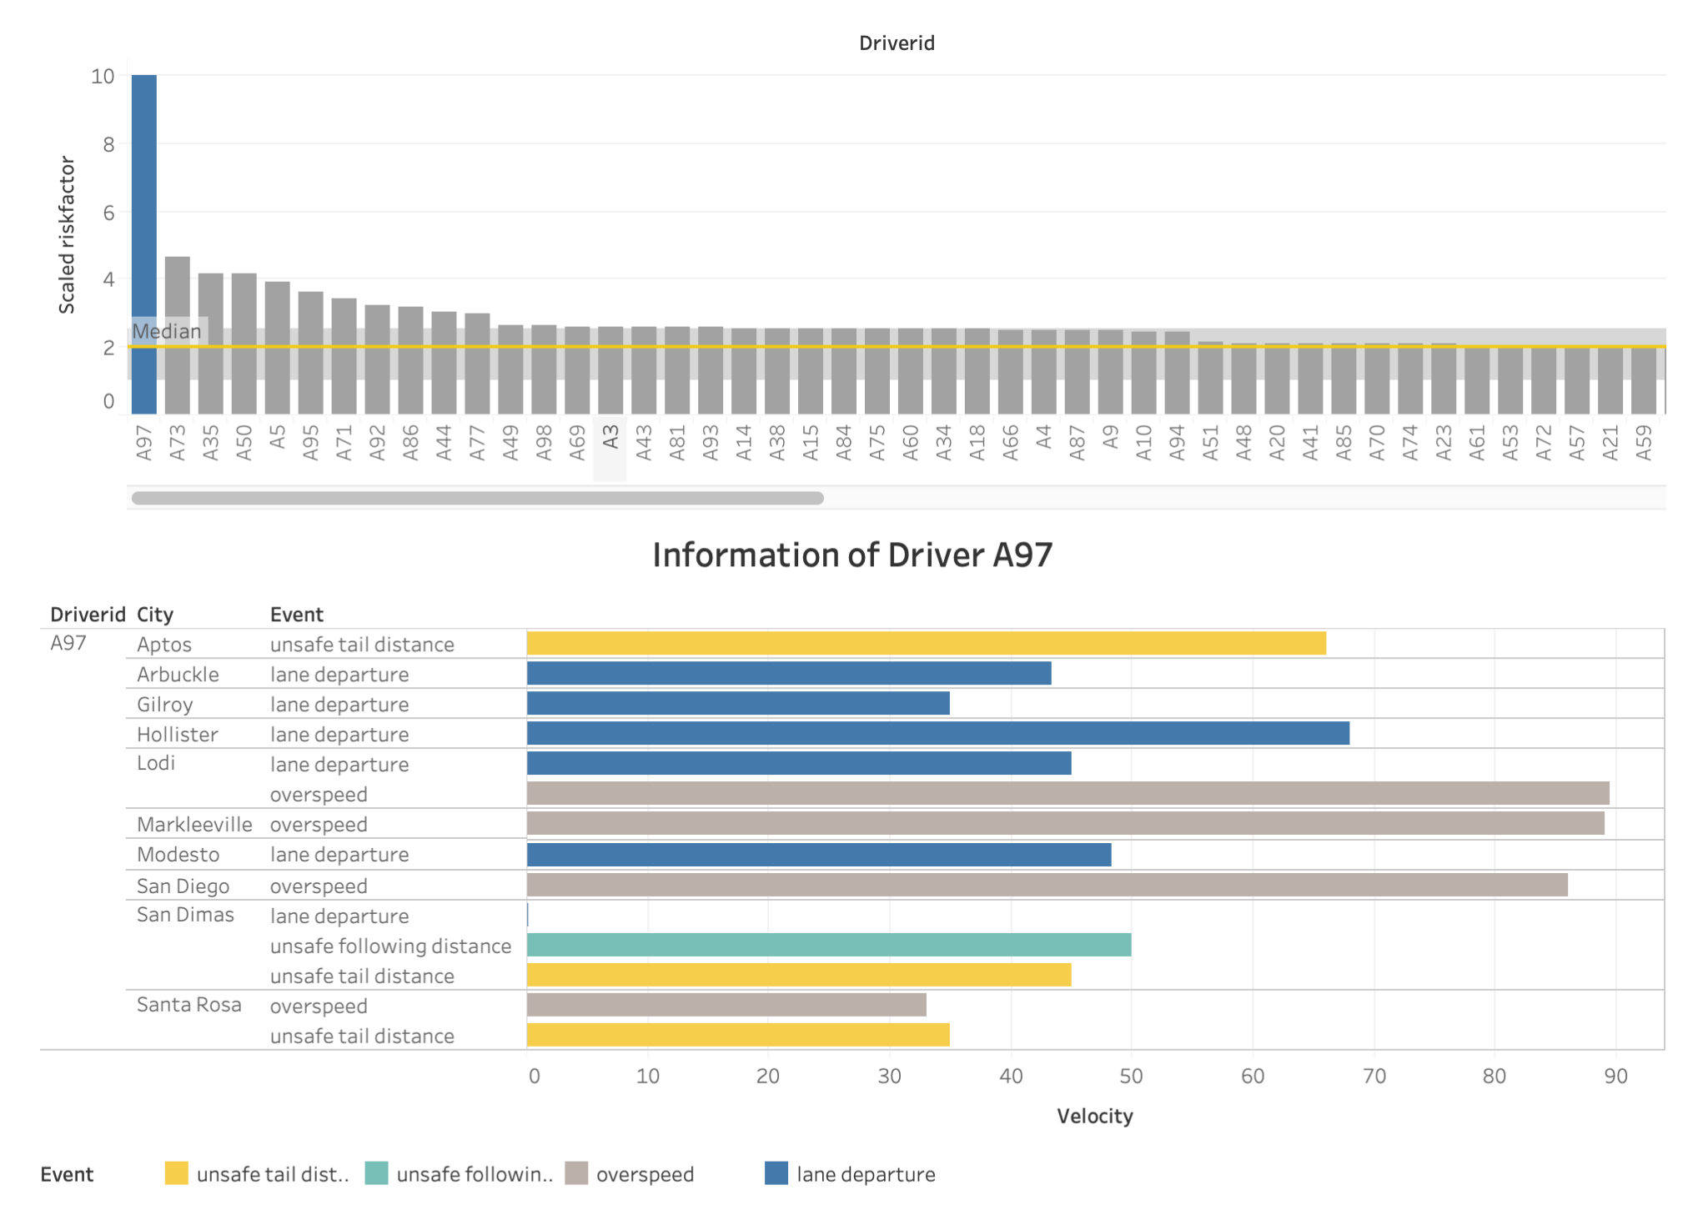
Should We Remove the Outlier A97?
Insights:
1. The histogram shows there is an outlier.
2. The bar plot shows that driver A97 is the outlier since the risk factor is higher than that of other drivers.
3. However, the table indicates that there is no abnormality. All events have different velocities, and the values look reasonable.
Results:
Based on the evidence, we decide to keep A97 in our analysis.

Slide 7
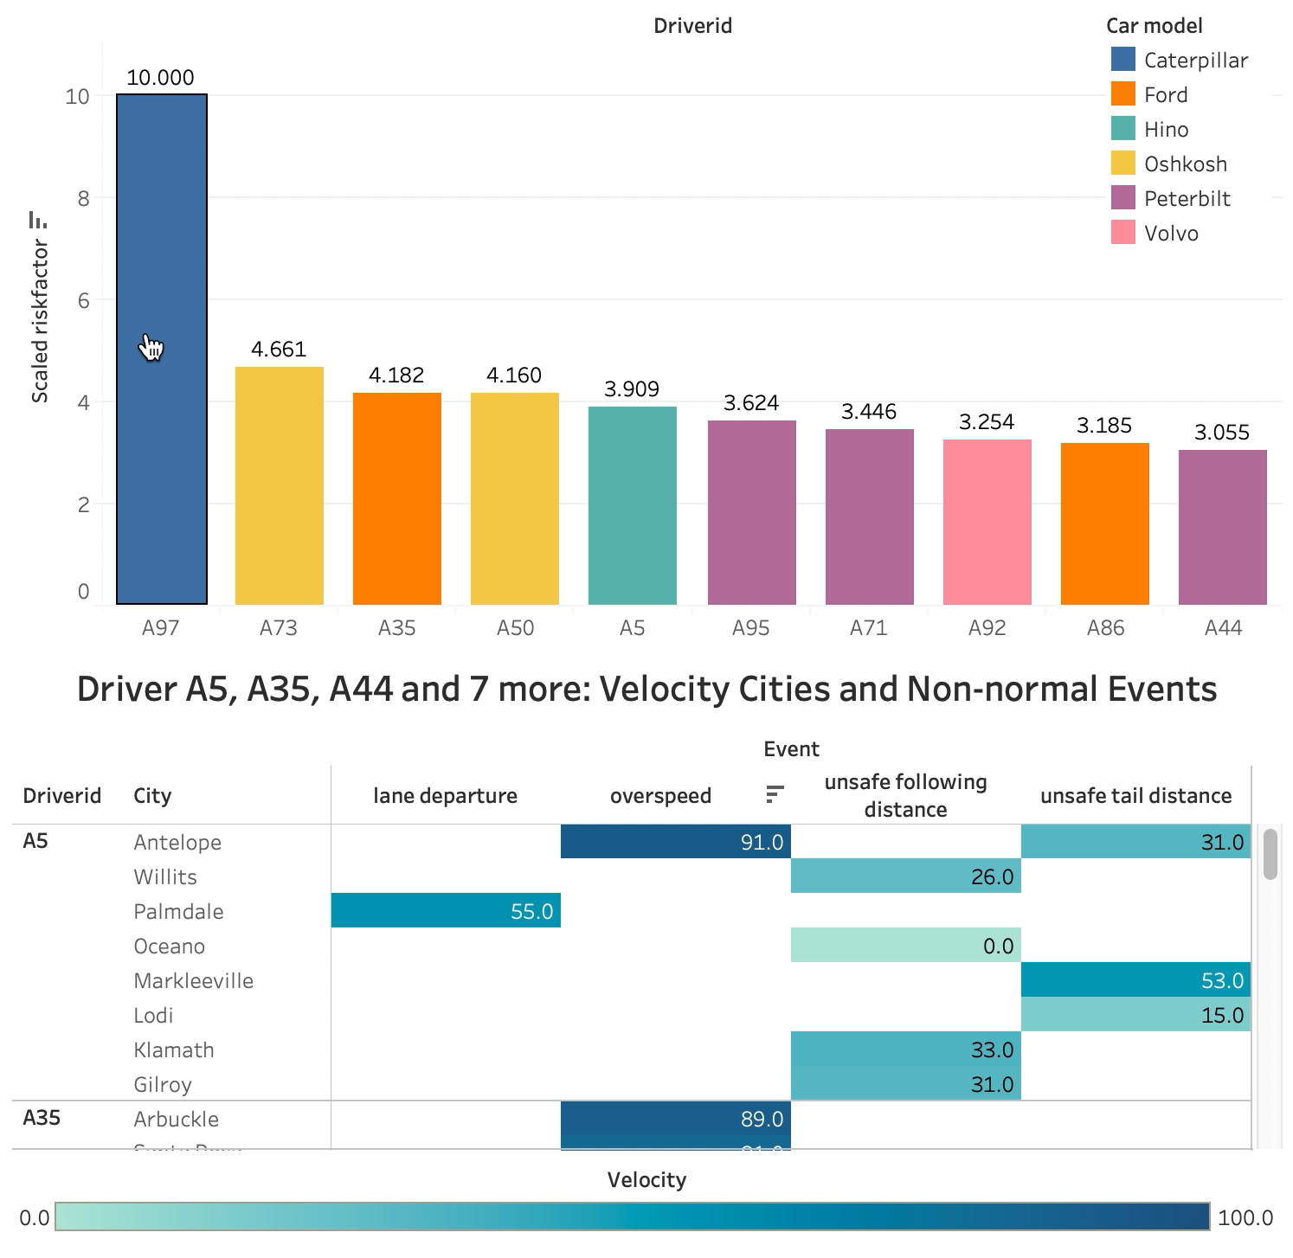
Top 10 Risky Drivers
Insights:
1. The bar plot shows the top 10 risky drivers and their truck models.
2. The table shows further information, such as state, city, abnormal event, and velocity, risk factor of the specific drivers.
Recommendation:
To decrease the number of incidents, the organization may want to track these ten drivers and know their driving behavior. Hence, the organization can head to table to find the detailed information.

Slide 8
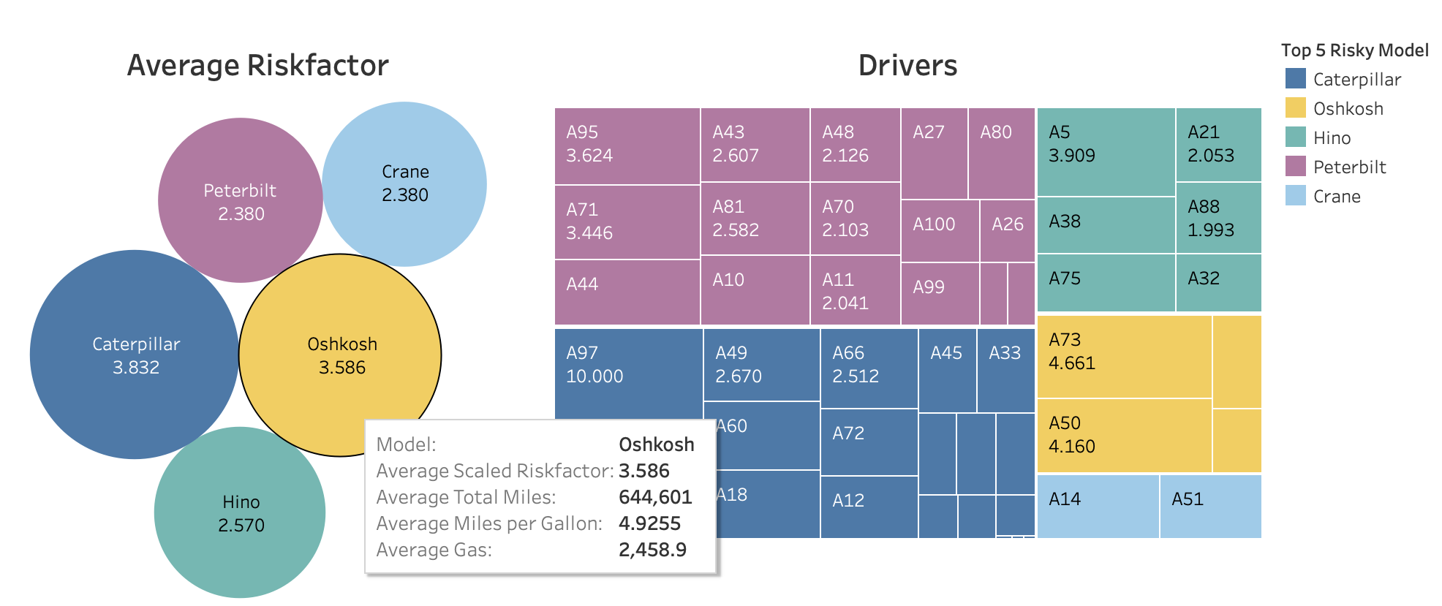
Top 5 Risky Truck Models
Insights:
1. The plots show the top 5 risky truck models are Caterpillar, Oshkosh, Hino, Peterbilt, and Crane.
2. The treemap indicates the drivers whose trucks are top 5 dangerous truck models and their riskfactor values.

Slide 9
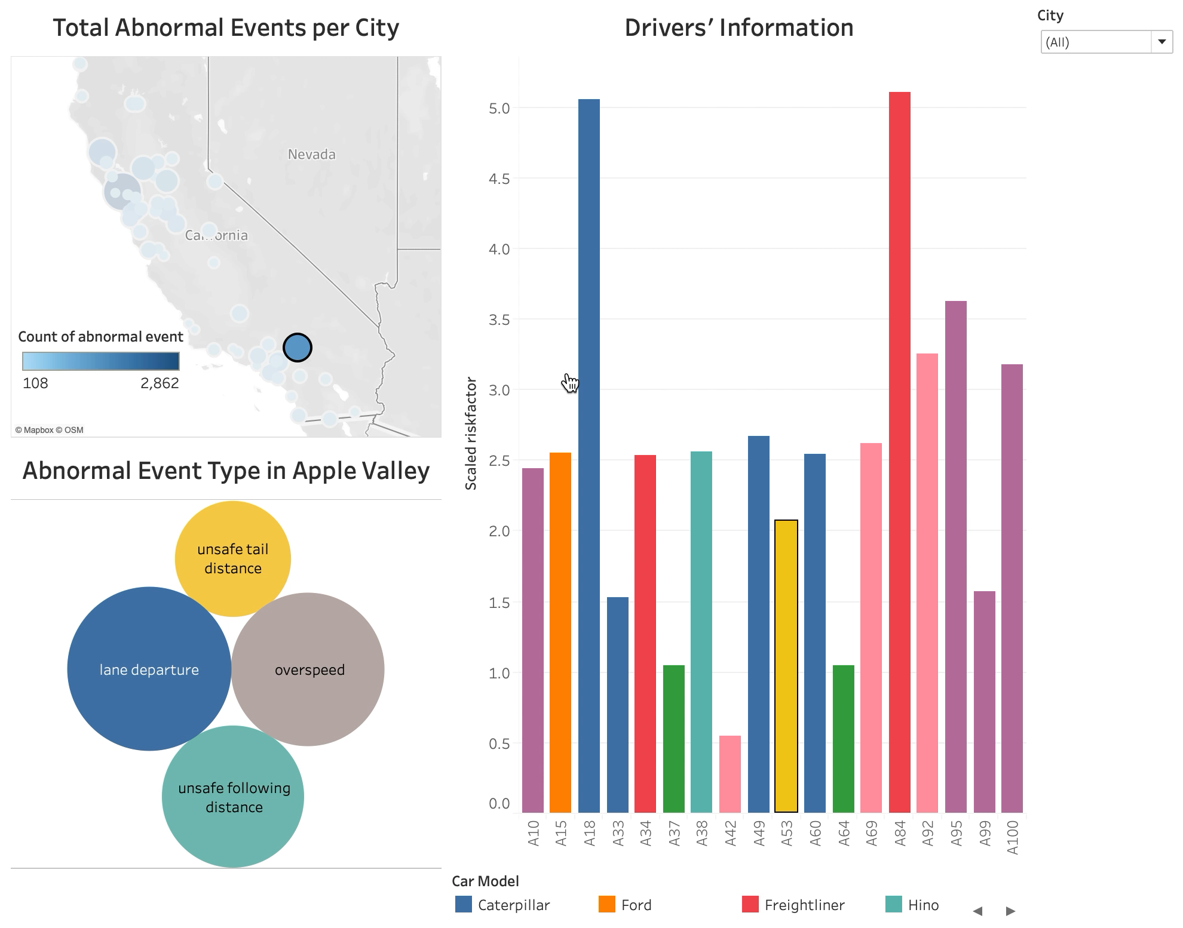
Geographical Analysis
Insights:
1. The map shows the count of events in each city. The larger circle and the darker color mean the number of abnormal events in that city is higher. For example, Santa Rosa has the highest number of abnormal events.
2. We can know which events occur most often in the selected city from the packed bubble chart.
3. At the same time, the bar chart shows the drivers' information in the selected city.
Recommendation:
The organization can develop strategies for each city to reduce incidents based on the proportion of event type.
Notes:
Recommendation:
For instance, lane departure takes up a large proportion in Ukiah. The organization may want to take a further look at what causes this.

Slide 10
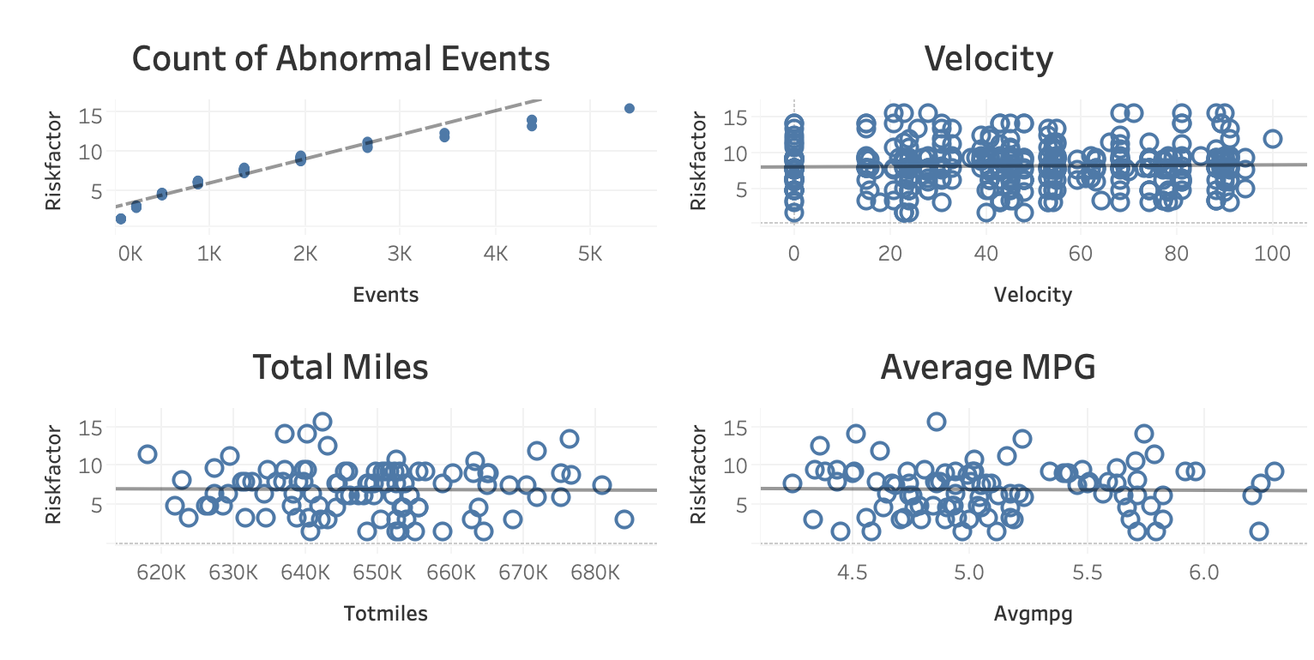
New Table for Regression
CREATE table predict_riskfactor
AS (
SELECT gs.driverid,
tm.truckid,
rs.riskfactor,
rs.events,
rs.totmiles,
max(gs.velocity) as max_speed,
avg(tm.mpg) as avg_mileage
FROM truck_mileage tm
JOIN geolocation_stage gs
JOIN riskfactor rs
ON gs.truckid = tm.truckid and rs.driverid= gs.driverid
GROUP BY tm.truckid,
gs.driverid,
rs.riskfactor,
rs.events,
rs.totmiles);

Slide 11
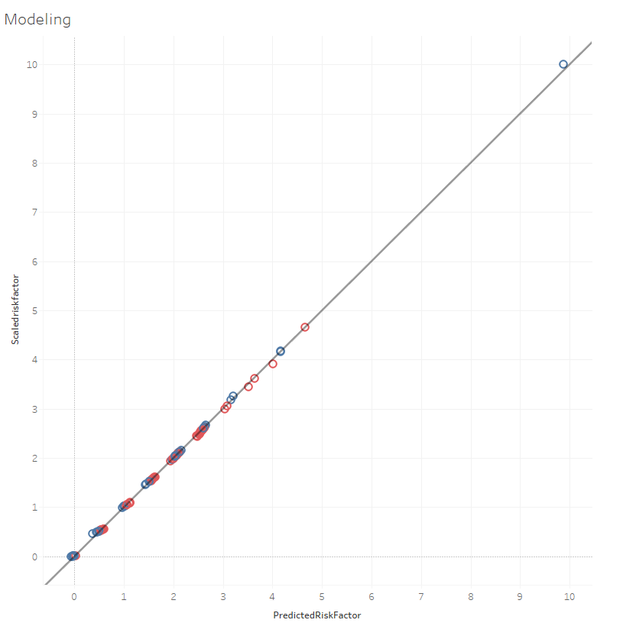
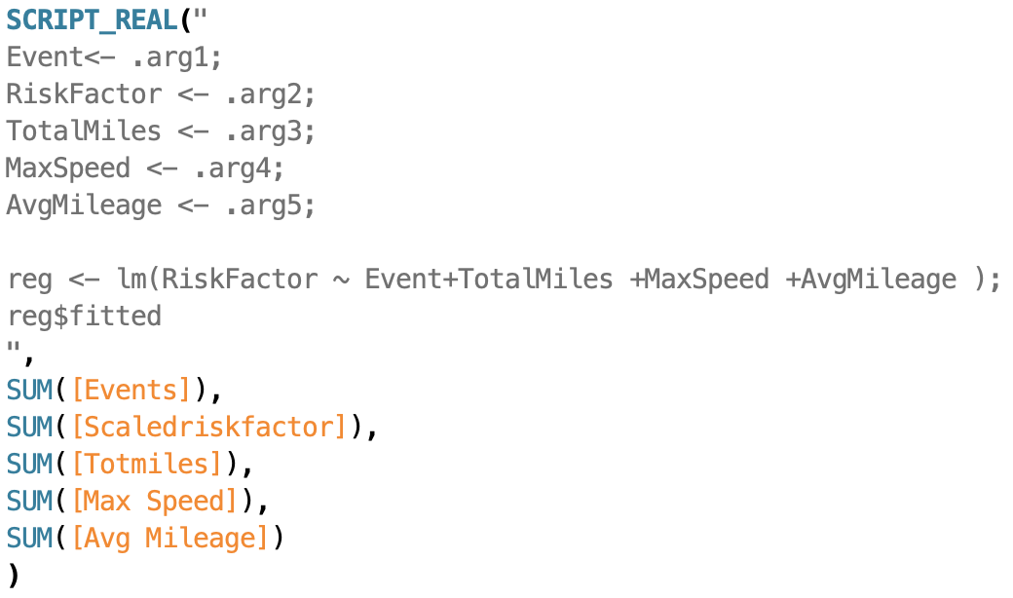
Predict the Scaled Risk Factor For Drivers
Predicted > Actual
Yes
No

Slide 12
Conclusion
Risk Factor did not only depend on the driver but also on other external factors such as truck model.
The type of abnormal events depends on geographical locations.
Predicting the risk factor for drivers using regression results in R.

